Slide 1
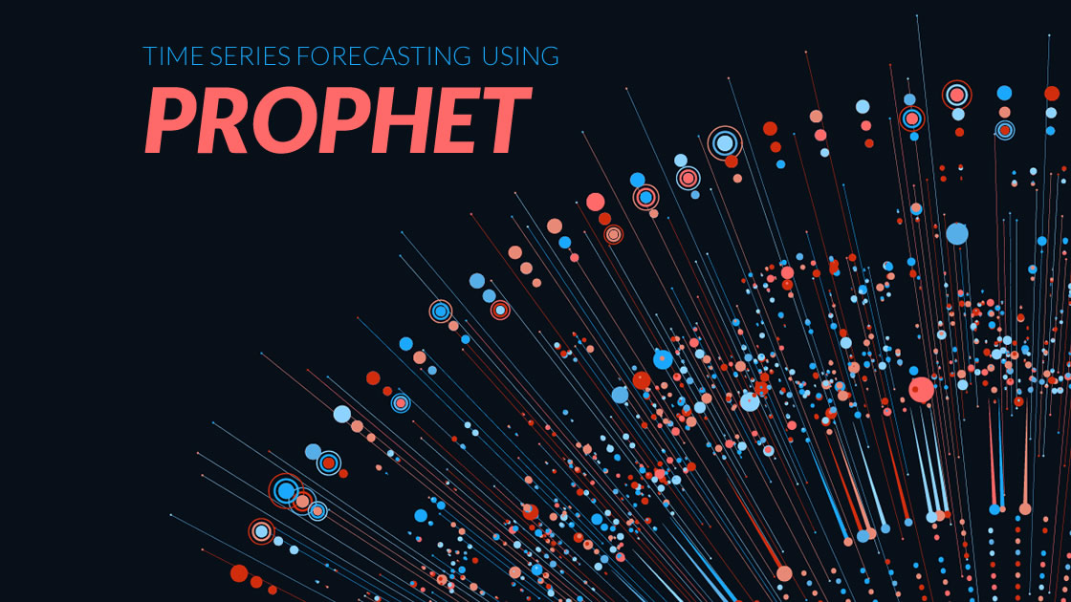
Forecast future sales with prophet library.
TNSDC IBM PROJECT
PHASE 2
team members:
a. Thirukarthikeyan[B.TECH IT]
v. Praveenkumar[B.TECH IT]
m .Vignesh [B.TECH IT ]
M .Abinesh [B.TECH IT]
A .Veluprasaath [B.TECH IT]

Slide 2
IMPLEMENTATION OF THE PROPHET IN FUTURE SALES(SALES FORECASTING)
INSTALL PYTHON LIBRARIES (PANDAS, FBPROPHET).
IMPORT THE LIBRARIES AND LOAD YOUR DATA SALES DATA FROM USING THE FBPROPHET DATAFRAME.
CREATE AND FIT THE PROPHET MODEL.
CREATE THE DATA FRAME FOR FUTURE SALES.
GENERATE THE FORECASTS
VISUALIZE THE RESULTS
ACCESSS THE FORECAST VALUES

Slide 3
LEVEL OF PROPHET IN FUTURE SALES
QUALITY OF DATA
MODEL TUNING
DATA CHARACTERSTICS
DOMAIN KNOWLEDGE
EVALUATION
DATA AVAILABILITY
EXTERNAL FACTORS
AUTOMATION

Slide 4
What is Prophet Technique
Prophet is a time series forecasting technique developed by facebook’s
Datascience team.
It is designed to handle daily observations that display patterns on different time scales.
Overview of prophet techniques:
Additive model
Trend component
Seasonality
Holiday effects
Automatic detection

Slide 5
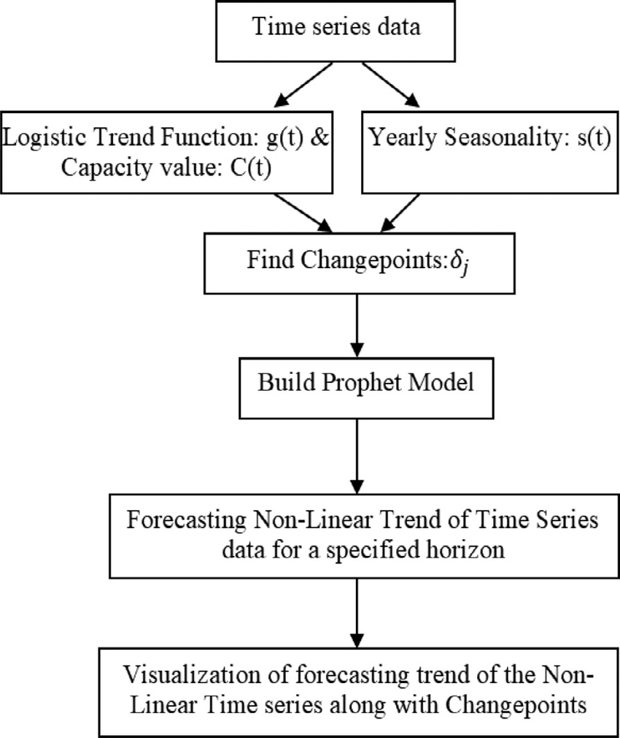
Steps for Prophet technique

Slide 6
Scope of prophet techniques
Robust handling of seasonality:-
Prophet is well suited for datasets with strong seasonal patterns, making it effective for industries where sales exhibit recurring trends.
Customization for holidays and special events:-
the ability to include custom holidays and special events allows business to tailor the model to their specific industry, accounting for unique factors influencing sales
Uncertainty estimation:-
The inclusion of uncertainty intervals in predictions provides a measure of the forecast’s reliability .this is valuable for business that need to access the level of confidence in their sales predictions.
Demonstrated success stories:-
numerous success stories across industries showcase the effectiveness of prophet in accurately predicting future sales ,in stilling confidence in its application for future forecasting endeavours.

Slide 7
Thank you

